Slide 1
Pharmacy Department Programmes

BPharm
HCert: Pharmacy Support

Slide 2
WELCOME
Staff welcome you to the Pharmacy Department
      Building 12 (Biological Sciences Building)
      2nd and 3rd Floors
Congratulate you, the first year students, on your choice
2013 – first year of presentation of:
      New integrated BPharm degree
      New Pharmacy Technical Assistant programme

Slide 3
PHARMACY DEPARTMENT Head of Department: Mrs Shirley-Anne Boschmans
Academic Staff: Programme and Stream Coordinators & Lecturers
BPharm Programme | Mrs S-A Boschmans
Clinical Pharmacy Stream | Mrs J McCartney
People and Systems Stream | Mrs S Burton
The Molecule Stream | Mrs M Keele
PTA Programme | Mrs T-L Fogarty
Postgraduate Programmes | Prof I Truter
Lecturers | Mrs J Barry Ms L Kritiotis Mr A Kritzinger Mrs N Kubashe Mr C Okafor Mrs J Rishworth Mr B Knoesen
BPharm Service Courses (1st & 2nd year): Anatomy & Physiology; Computers; Chemistry; Physics: Biochemistry; Microbiology

Slide 4
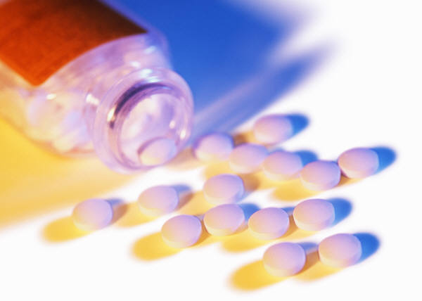
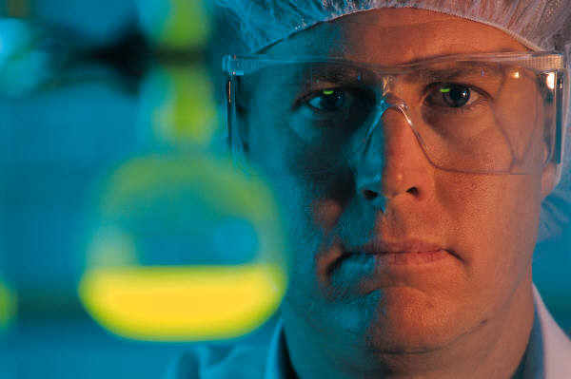
PHARMACY DEPARTMENT Head of Department: Mrs Shirley-Anne Boschmans
Support Staff:
Laboratory technicians | Mrs J Taylor Mrs E Newman Mrs N Skhosana Mrs A van Jaarsveld Mrs J van Jaarsveld
Laboratory Assistants | Mrs E Boltina Mr W Grauman Mrs C Laxa Mrs M Tube

Slide 5


BACKGROUND
Bodies involved in Pharmacy
Statutory Body
South African Pharmacy Council
Professional Body
Pharmaceutical Society of SA

Slide 6
Registration with SAPC
BPharm Students
      Register with SAPC as from 1st year
      Registration category – Pharmacy Student
      Registration Fee: R367.90
      Annual registration required 2nd to 4th year
      Annual Fee: R173.29
PTA Students
      Register with SAPC
      Details still to be announced by SAPC

Slide 7
)
Bachelor of Pharmacy Degree (BPharm)

Pharmacist

Slide 8
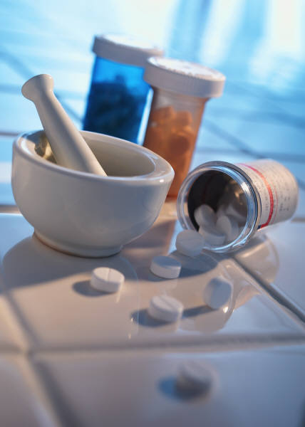
The BPharm Degree
4 year Bachelors degree
Internship (1 year)
Community service (1 yr)
Registration as a pharmacist (South African Pharmacy Council)

Slide 9
INTEGRATED CURRICULUM
Foundation Courses
Integrated BPharm
The Molecule
People & Systems
Clinical Pharmacy

Slide 10
First Year Modules
Foundation Programmes
      Anatomy and Physiology for Pharmacists ZFP101, ZFP102
      Biochemistry for Pharmacists ZFB102
      Organic Chemistry for Pharmacists ZFC101
      Computing Fundamentals WRFV101
The Molecule
      Pharmaceutical Chemistry ZTM101
      Physics for Pharmacists ZTM121
      Physical Pharmacy ZTM102
People & Systems
      Pharmacy People and Systems ZPS122
Clinical Pharmacy – BPharm2
Foundation Courses
Integrated BPharm
The Molecule
People & Systems
Clinical Pharmacy

Slide 11
IN CONCLUSION
+ 4 YEARS

Slide 12
Higher Certificate: Pharmacy Support

Pharmacy Technical Assistant (PTA)

Slide 13
Midlevel Worker Qualifications
1 year Higher Certificate
Supervised practice
Registration as a Pharmacy Technical Assistant (South African Pharmacy Council)
1 year Advanced Certificate
Supervised practice
Registration as a Pharmacy Technician (South African Pharmacy Council)

Slide 14
Higher CertificateModules
1 YEAR PROGRAMME:
Pharmacy in Practice ZPA101, ZPA102
Practical Pharmaceutics ZAP101, ZAP102
Clinical Medicine Use ZAC101, ZAC102
Pharmacy Business Environment ZAM101, ZAM102
One elective module – choice between 2 options
      Health and Wellness Promotion ZAH100
      Information and Communication Technology in Pharmacy ZAR100

Slide 15
IN CONCLUSION
+ 1 YEAR

Slide 16
Achievements….
Staff actively involved in professional activities:
  South African Pharmacy Council (SAPC), Academy of Pharmaceutical Sciences, Pharmaceutical Society of South Africa (PSSA) and other national and international bodies
Staff have well established research records – supervision of postgraduate students (masters & doctoral level); scientific publications; conference presentations; serve on editorial / review panels of scientific journals
    One NRF rated researcher (Truter)
    Prof Ilse Truter - Top Researcher in Faculty of Health Sciences
    Fulbright scholar & NMMU Rising Star – Ms Milli Reddy
    Brian Seymour national award – Charl Botha, Michelle Bennett & Raydon Juta

Slide 17
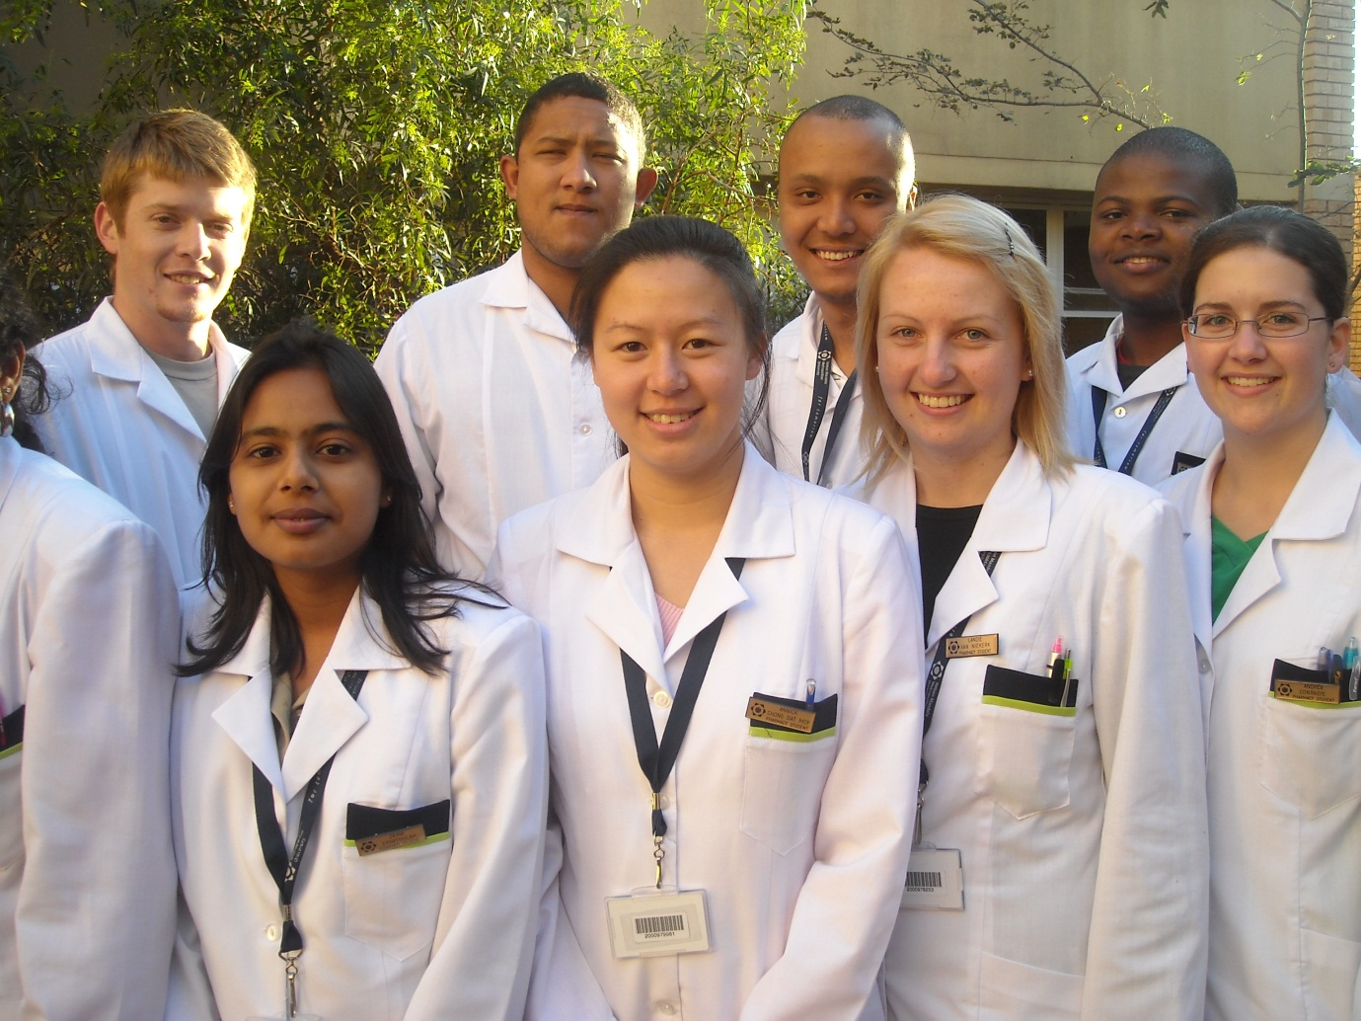
Achievements….
Consistently produce top performing graduates in the national pre-registration exam set by SAPC (South African Pharmacy Council)
Excellent working relationship with local pharmacists in public and private sectors - experiential on-site learning programmes

Slide 18
Highlights ….
National Dept Education granted R24 million refurbishment funding
  ensure state-of-the-art training facilities - 2012
New Integrated BPharm curriculum to ensure undergraduate training is modern, in line with international trends and relevant to South Africa’s needs
First University in South Africa to train mid level workers Pharmacy Technical Assistant Programme (Higher Certificate)

Slide 19
What happens next? .. compulsory events
BPharm & HCert orientation programme
Weds 30th Jan | Registration on South Campus (Indoor Sports Centre) HCert in Pharmacy Support - 08:30-09:30 B Pharm - 09:30-10:30
Wed 6th Feb | Departmental meeting BPharm1 at 09h00 HCert at 11:00 on South Campus in 12-02-88 Meet the staff ; prepare for lectures; PEPSA fun event BPharm1:14h00 – 15h00 Computing Fundamentals (WFRV101) Venue: 123 00 07
Thur 7th Feb | How2@nmmu Buddy programme 09h00 – 15h00 in 12 02 88
Mon 11th Feb 2012 | Lectures start

Slide 20
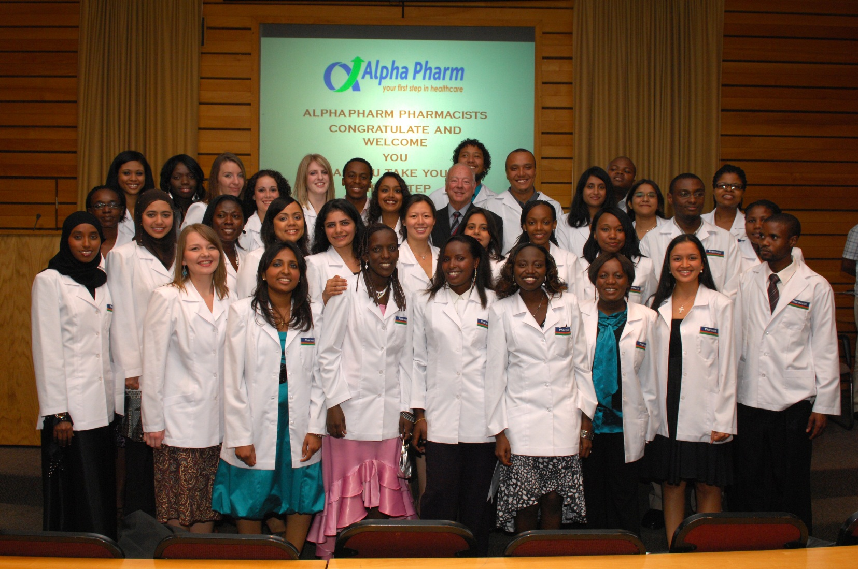
Nelson Mandela Metropolitan University..
training pharmacists for tomorrow…..

Slide 21
Pharmacy @ NMMU
CONTACT DETAILS
Web: www.nmmu.ac.za/pharmacy
Email: pharmacy@nmmu.ac.za
Telephone: (041) 504-2128 (office hours)
Fax: (041) 504-2744

